Slide 1
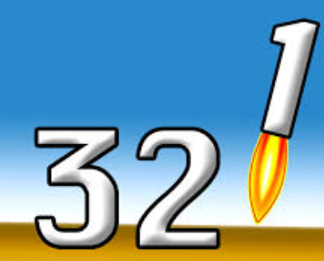
Specialised exchange surfaces
Tuesday, 30 December 2014
Key words: alveoli, villi, diffusion
Starter: Recap your understanding of the lungs
3: Parts of the lungs
2: Differences between inhalation and exhalation
1: Definition of gas exchange

Slide 2
The big picture: “How are exchange surfaces specialised?”
Learning outcomes
To describe the adaptations of the alveoli and villi.
To analyse how these adaptations allow these exchange structures to function effectively.
To evaluate the use of artificial breathing aids.

Slide 3
Specialised exchange surfaces
Areas of the body where exchange takes place e.g. the alveoli in the lungs and the small intestine are specially designed for this job.
The have key features (adaptations) to maximise the rate of diffusion- this ensures the products being exchanged are delivered as quickly as possibly.

Slide 4
Task
Complete the tasks on your worksheet to explain the role and adaptations of the alveoli in the lungs and the villi in the small intestine.
Support: Text books page , phones
Extra challenge: Why would single celled organisms such as amoeba need to have similar adaptations in order to survive?

Slide 5
6 Mark Exam question
“Explain how the villi in the small intestine are adapted to maximise the rate of absorption of digested food products”

Slide 6
Self-assessment- max 6 marks
Many microvilli
Large surface area
Many capillaries/ good blood supply
Concentration gradient maintained/ quick diffusion into the blood
Thin walls/ 1 cell thick
Short diffusion distance
Many mitochondria
Provides energy for active transport

Slide 7
Artificial breathing aids
1. Read about the 3 types of breathing aids- highlight the key points and stick the information in your books.
2. Write the benefits/ drawbacks of each method in your books- discuss the answers with the people on your table.

Slide 8

Plenary: Mr Wrong
Read these wrong sentences and write the correct answers in your books…
Alveoli and villi have a small surface area.
The walls of the alveoli are 2 cells thick.
Villi do not contain any mitochondria.
The iron lung works using positive pressure.
The shell ventilator works in a similar way to the positive pressure ventilators.

Slide 9
Resources

Slide 10
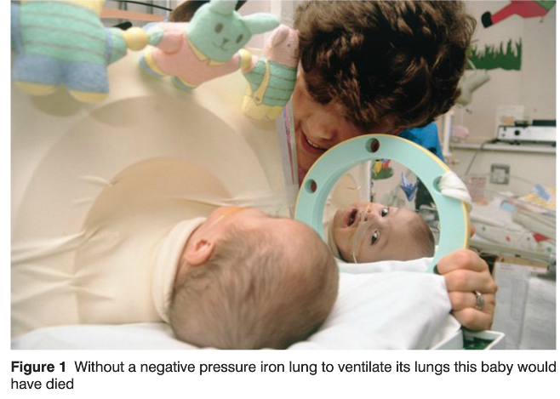
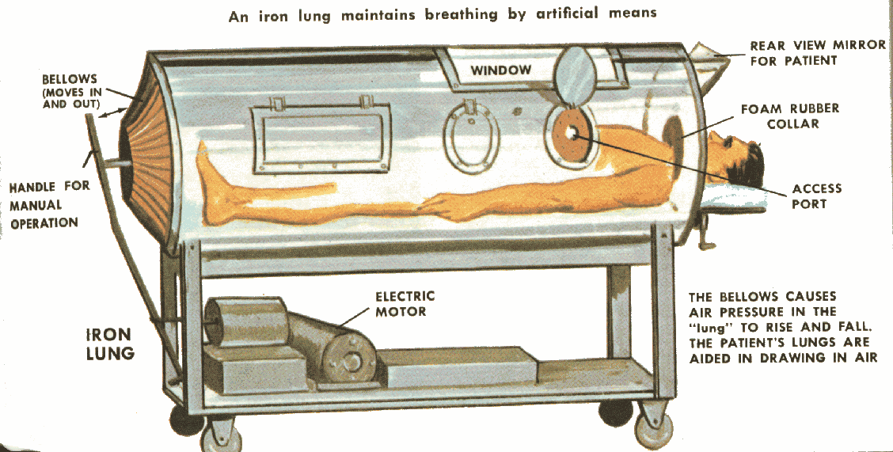
Iron Lung
Patient is enclosed in the device with only head poking out
An airtight seal is made around the neck and shoulders
Air is pumped out of the chamber using bellows
A vacuum is created, providing negative pressure, which causes movement of the thorax to draw in air
Works using negative pressure!!
What are the associated pros and cons of this device?

Slide 11
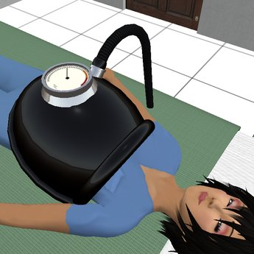
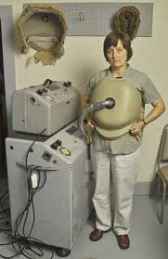
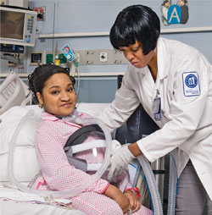
The Shell
The shell is fitted around the thorax of the patient
Works in a similar way to the iron lung
Air is removed from inside the shell to create a vacuum
The vacuum moves the thorax in a similar way to when a person breathes in unaided
Air is drawn into to the lungs
To stimulate expiration the air is returned to the chamber to increase the pressure
What are the benefits and drawbacks?
Works using negative pressure!!

Slide 12
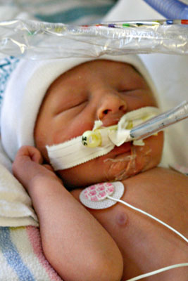
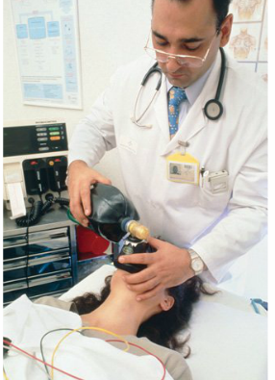
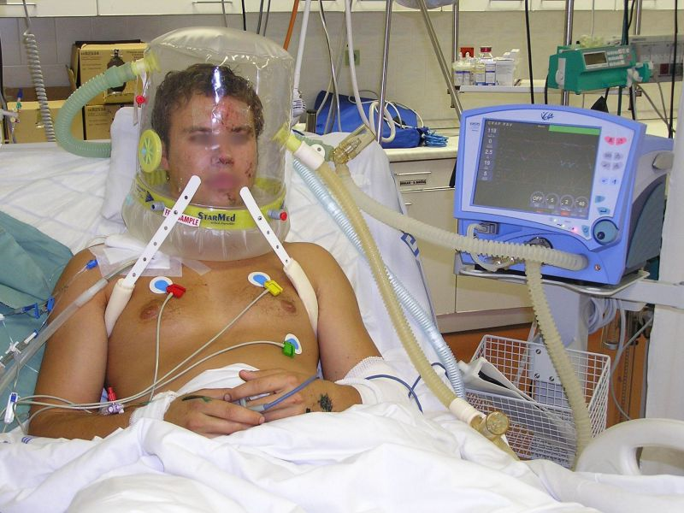
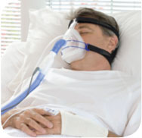
Positive Pressure Ventilators
Positive pressure systems force air down the trachea into the lungs
The volume of air delivered is carefully monitored in electrical positive pressure systems
Once the lungs have been ventilated the air flow cuts off and the lungs are allowed to deflate
Manual positive pressure systems are often used in emergency procedures
What are the advantages and disadvantages?
Works using positive pressure!!

Slide 13
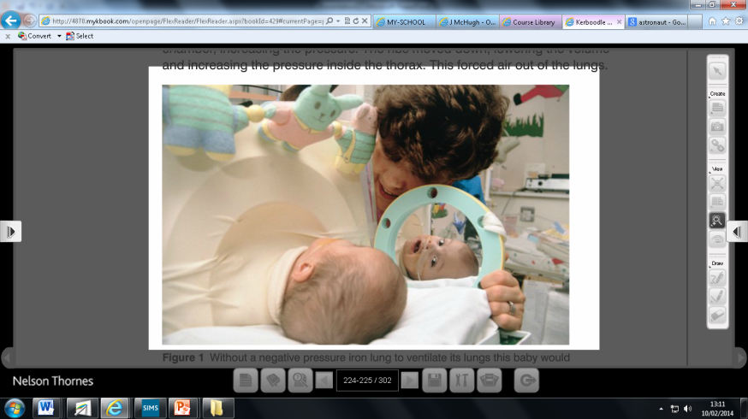
Breathing Aid | Advantages | Disadvantages
Iron Lung
(negative pressure)
The Shell
(negative pressure)
Positive Pressure Ventilator

